Slide 1
Neural networks
David Kauchak
CS158 – Fall 2023

Slide 2
Admin
Assignment 7

Slide 3
Perceptron learning algorithm
repeat until convergence (or for some # of iterations):
for each training example (f₁, f₂, …, f_{n}, label):
if prediction * label ≤ 0: // they don’t agree
for each w_{i}:
w_{i} = w_{i} + f_{i}*label
b = b + label
Why is it called the “perceptron” learning algorithm if what it learns is a line? Why not “line learning” algorithm?

Slide 4
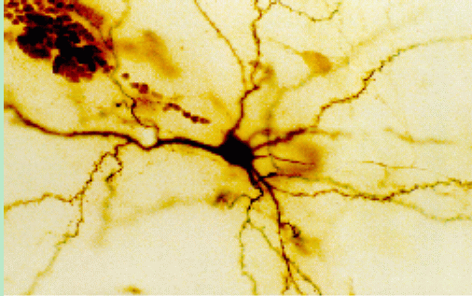
Our Nervous System
Neuron
What do you know?

Slide 5
Our nervous system: the computer science view
the human brain is a large collection of interconnected neurons
a NEURON is a brain cell
they collect, process, and disseminate electrical signals
they are connected via synapses
they FIRE depending on the conditions of the neighboring neurons

Slide 6
A neuron/perceptron
Input x₁
Weight w₁
Weight w₂
Input x₂
Output y
activation function
Input x₃
Weight w₃
Weight w₄
Input x₄
How is this a linear classifier (i.e. perceptron)?

Slide 7
Hard threshold = linear classifier
hard threshold:
x₁
w₁
x₂
w₂
output
…
w_{m}
x_{m}

Slide 8
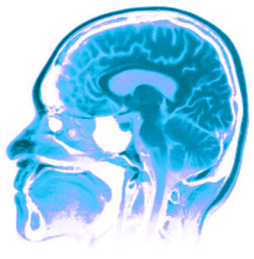
Neural Networks
Neural Networks try to mimic the structure and function of our nervous system
People like biologically motivated approaches

Slide 9
Artificial Neural Networks
Node (Neuron/perceptron)
Edge (synapses)
our approximation

Slide 10
Node A
Weight w
Node B
(perceptron)
(perceptron)
W is the strength of signal sent between A and B.
If A fires and w is positive, then A stimulates B.
If A fires and w is negative, then A inhibits B.

Slide 11
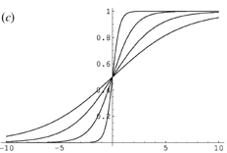
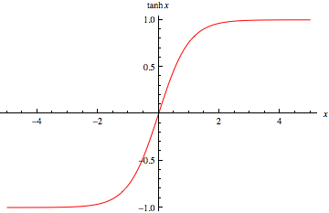
Other activation functions
hard threshold:
sigmoid
tanh x
why other threshold functions?
Notes:
Allows us to model more than just 0/1 outputs
Differentiable! (this will come into play in a minute)

Slide 12
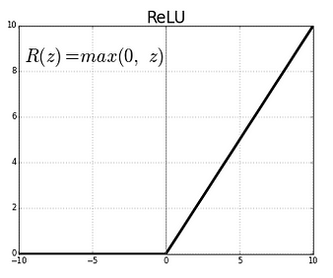
Many other activation functions
Rectified Linear Unit (RLU)
Softmax (for probabilities)

Slide 13
Neural network
inputs
Individual perceptrons/neurons
Notes:
- often we view a slice of them

Slide 14
Neural network
some inputs are provided/entered
inputs
Notes:
- often we view a slice of them

Slide 15
Neural network
inputs
each perceptron computes and calculates an answer
Notes:
- often we view a slice of them

Slide 16
Neural network
inputs
those answers become inputs for the next level
Notes:
- often we view a slice of them

Slide 17
Neural network
inputs
finally get the answer after all levels compute
Notes:
- often we view a slice of them

Slide 18
Activation spread
http://www.youtube.com/watch?v=Yq7d4ROvZ6I

Slide 19
Computation (assume 0 bias)
0.5
0
0
0.5
1
-1
-0.5
1
1
0.5
1

Slide 20
Computation
-0.05-0.02= -0.07
0.05
0.483
0.483*0.5+0.495=0.7365
-1
0.03
0.5
-0.02
0.676
0.01
1
1
0.495
-0.03+0.01=-0.02

Slide 21
Neural networks
Different kinds/characteristics of networks
inputs
inputs
inputs
inputs
How are these different?

Slide 22
Hidden units/layers
inputs
inputs
hidden units/layer
Feed forward networks

Slide 23
Hidden units/layers
inputs
Can have many layers of hidden units of differing sizes
To count the number of layers, you count all but the inputs
…

Slide 24
Hidden units/layers
inputs
inputs
2-layer network
3-layer network

Slide 25
Alternate ways of visualizing
Sometimes the input layer will be drawn with nodes as well
inputs
inputs
2-layer network
2-layer network

Slide 26
Multiple outputs
inputs
0
1
Can be used to model multiclass datasets or more interesting predictors, e.g., images

Slide 27
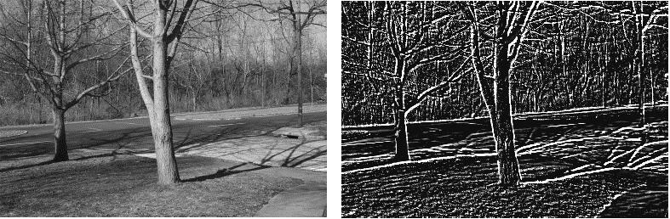
Multiple outputs
input
output
(edge detection)

Slide 28
Neural networks
inputs
Recurrent network
Output is fed back to input
Can support memory!
Good for temporal/sequential data

Slide 29
NN decision boundary
x₁
w₁
x₂
w₂
output
…
w_{m}
x_{m}
What does the decision boundary of a perceptron look like?
Line (linear set of weights)

Slide 30
NN decision boundary
What does the decision boundary of a 2-layer network look like?
Is it linear?
What types of things can and can it not model?

Slide 31
XOR
?
Input x₁
?
?
Output = x₁ xor x₂
b=?
?
?
?
b=?
Input x₂
x₁ | x₂ | x₁ xor x₂
0 | 0 | 0
0 | 1 | 1
1 | 0 | 1
1 | 1 | 0
b=?

Slide 32
XOR
1
Input x₁
1
-1
Output = x₁ xor x₂
b=-0.5
-1
1
1
b=-0.5
Input x₂
x₁ | x₂ | x₁ xor x₂
0 | 0 | 0
0 | 1 | 1
1 | 0 | 1
1 | 1 | 0
b=-0.5

Slide 33
What does the decision boundary look like?
1
Input x₁
1
-1
Output = x₁ xor x₂
b=-0.5
-1
1
1
b=-0.5
Input x₂
x₁ | x₂ | x₁ xor x₂
0 | 0 | 0
0 | 1 | 1
1 | 0 | 1
1 | 1 | 0
b=-0.5

Slide 34
What does the decision boundary look like?
1
Input x₁
1
-1
Output = x₁ xor x₂
b=-0.5
-1
1
1
b=-0.5
Input x₂
x₁ | x₂ | x₁ xor x₂
0 | 0 | 0
0 | 1 | 1
1 | 0 | 1
1 | 1 | 0
b=-0.5
What does this perceptron’s decision boundary look like?

Slide 35
NN decision boundary
Input x₁
-1
x₂
(-1,1)
1
Input x₂
x₁
b=-0.5
Let x₂ = 0, then:
(without the bias)

Slide 36
NN decision boundary
Input x₁
-1
x₂
1
Input x₂
x₁
b=-0.5

Slide 37
What does the decision boundary look like?
1
Input x₁
1
-1
Output = x₁ xor x₂
b=-0.5
-1
1
1
b=-0.5
Input x₂
x₁ | x₂ | x₁ xor x₂
0 | 0 | 0
0 | 1 | 1
1 | 0 | 1
1 | 1 | 0
b=-0.5
What does this perceptron’s decision boundary look like?

Slide 38

NN decision boundary
1
Input x₁
x₂
b=-0.5
-1
Input x₂
x₁
Let x₂ = 0, then:
(1,-1)
$$x1−0.5=0$$
(without the bias)

Slide 39
NN decision boundary
1
Input x₁
x₂
b=-0.5
-1
Input x₂
x₁

Slide 40
What does the decision boundary look like?
1
Input x₁
1
-1
Output = x₁ xor x₂
b=-0.5
-1
1
1
b=-0.5
Input x₂
x₁ | x₂ | x₁ xor x₂
0 | 0 | 0
0 | 1 | 1
1 | 0 | 1
1 | 1 | 0
b=-0.5
What operation does this perceptron perform on the result?

Slide 41
Fill in the truth table
1
1
b=-0.5
out1 | out2
0 | 0 | ?
0 | 1 | ?
1 | 0 | ?
1 | 1 | ?

Slide 42
OR
1
1
b=-0.5
out1 | out2
0 | 0 | 0
0 | 1 | 1
1 | 0 | 1
1 | 1 | 1

Slide 43
What does the decision boundary look like?
1
Input x₁
1
-1
Output = x₁ xor x₂
b=-0.5
-1
1
1
b=-0.5
Input x₂
x₁ | x₂ | x₁ xor x₂
0 | 0 | 0
0 | 1 | 1
1 | 0 | 1
1 | 1 | 0
b=-0.5

Slide 44
1
Input x₁
1
-1
Output = x₁ xor x₂
x₂
b=-0.5
-1
1
1
b=-0.5
Input x₂
x₁
b=-0.5
If either predicts positive, example is positive

Slide 45
1
Input x₁
1
-1
Output = x₁ xor x₂
x₂
b=-0.5
-1
1
1
b=-0.5
Input x₂
x₁
b=-0.5
x₁ | x₂ | x₁ xor x₂
0 | 0 | 0
0 | 1 | 1
1 | 0 | 1
1 | 1 | 0

Slide 46
What does the decision boundary look like?
Input x₁
Output = x₁ xor x₂
Input x₂
linear splits of the feature space
combination of these linear spaces

Slide 47
This decision boundary?
?
Input x₁
?
?
Output
b=?
?
?
?
b=?
Input x₂
b=?

Slide 48
This decision boundary?
1
Input x₁
-1
-1
Output
b=-0.5
-1
1
-1
b=0.5
Input x₂
b=-0.5

Slide 49
This decision boundary?
1
Input x₁
-1
-1
Output
b=-0.5
-1
1
-1
b=0.5
Input x₂
b=-0.5

Slide 50
-1
-1
b=0.5
out1 | out2
0 | 0 | ?
0 | 1 | ?
1 | 0 | ?
1 | 1 | ?

Slide 51
NOR
-1
-1
b=0.5
out1 | out2
0 | 0 | 1
0 | 1 | 0
1 | 0 | 0
1 | 1 | 0

Slide 52
What does the decision boundary look like?
Input x₁
Output = x₁ xor x₂
Input x₂
combination of these linear spaces
linear splits of the feature space

Slide 53
Three hidden nodes

Slide 54
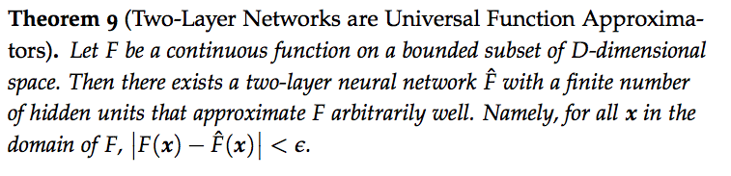
NN decision boundaries
Put simply: two-layer networks can approximate any function

Slide 55
NN decision boundaries
For DT, as the tree gets larger, the model gets more complex
The same is true for neural networks: more hidden nodes = more complexity
Adding more layers adds even more complexity (and much more quickly)
Good rule of thumb:
number of examples
number of 2-layer hidden nodes ≤
number of dimensions

Slide 56
Training
?
Input x₁
?
?
Output = x₁ xor x₂
b=?
?
?
?
b=?
Input x₂
x₁ | x₂ | x₁ xor x₂
0 | 0 | 0
0 | 1 | 1
1 | 0 | 1
1 | 1 | 0
b=?
How do we learn the weights?

Slide 57
Training multilayer networks
perceptron learning: if the perceptron’s output is different than the expected output, update the weights
gradient descent: compare output to label and adjust based on loss function
Any other problem with these for general NNs?
w
w
w
w
w
w
w
w
w
w
w
w
perceptron/ linear model
neural network

Slide 58
Learning in multilayer networks
Challenge: for multilayer networks, we don’t know what the expected output/error is for the internal nodes!
how do we learn these weights?
w
w
w
w
w
w
w
w
w
expected output?
w
w
w
perceptron/ linear model
neural network

Slide 59
Backpropagation: intuition
Gradient descent method for learning weights by optimizing a loss function
calculate output of all nodes
calculate the weights for the output layer based on the error
“backpropagate” errors through hidden layers

Slide 60
Backpropagation: intuition
We can calculate the actual error here

Slide 61
Backpropagation: intuition
Key idea: propagate the error back to this layer

Slide 62
Backpropagation: intuition
“backpropagate” the error:
Assume all of these nodes were responsible for some of the error
How can we figure out how much they were responsible for?

Slide 63
Backpropagation: intuition
w₂
w₃
w₁
error
error for node is ~ w_{i} * error

Slide 64
Backpropagation: intuition
w₅
w₄
w₆
w₃ * error
Calculate as normal using this as the error

Slide 65
Backpropagation: the details
Gradient descent method for learning weights by optimizing a loss function
calculate output of all nodes
calculate the updates directly for the output layer
“backpropagate” errors through hidden layers
What loss function?

Slide 66
Backpropagation: the details
Gradient descent method for learning weights by optimizing a loss function
calculate output of all nodes
calculate the updates directly for the output layer
“backpropagate” errors through hidden layers
squared error

